Slide 1
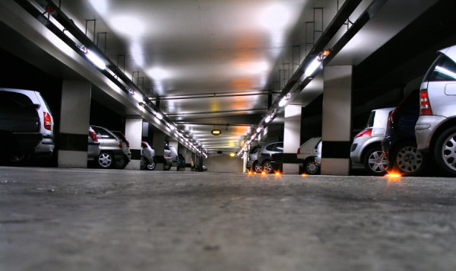
Atmiya College Parking
Home Guest Permit Premium Permit Payment Report Terms Of Service Contact Us

Slide 2
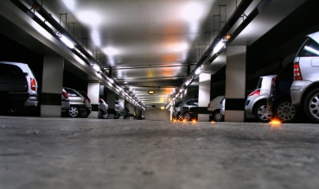
Page Flow – Guest Permit
Atmiya College Parking
Guest Permit
Home Guest Permit Premium Permit Payment Report - Terms Of Service Contact Us
links
Name:
Licence plate number:
Duration:
Email:
Provide Form
picture
Store Data
Guest Permit
Form has been completed!
Message

Slide 3
Page Flow – Premium Permit
Atmiya College Parking
Premium Permit
Home Guest Permit Premium Permit Payment Report - Terms Of Service Contact Us
links
Name:
Licence plate number:
Duration:
Email:
Selected Permanent Parking spot:
Provide Form
picture
Store Data
Premium Permit
Form has been completed!
Message

Slide 4
Page Flow - Payment
Atmiya College Parking
Payment
Home Guest Permit Premium Permit Payment Report - Terms Of Service Contact Us
links
Mastercard
Visa
Provide options
picture
Store Data
Payment
Payment Confirmed! Receipt sent to your email!
Message

Slide 5
Page Flow - Report
Report - OHS
Atmiya College Parking
Report
Home Guest Permit Premium Permit Payment Report - Terms Of Service Contact Us
Safety Issue
links
OHS
Parking
Report - Parking
picture
Licence number:
Parking spot/area:
Proof of incident (photo):
Record data
Report
Record data
Thank you for your report!
Provide message

Slide 6
Page Flow – ToS
Atmiya College Parking
Terms Of Service
Home Guest Permit Premium Permit Payment Report - Terms Of Service Contact Us
links
Terms of service Terms of service Terms of service Terms of service Terms of service Terms of service Terms of service Terms of service Terms of service Terms of service Terms of service Terms of service Terms of service Terms of service Terms of service Terms of service Terms of service Terms of service Terms of service Terms of service Terms of service Terms of service Terms of service Terms of service Terms of service Terms of service Terms of service Terms of service Terms of service Terms of service Terms of service Terms of service Terms of service Terms of service Terms of service Terms of service Terms of service Terms of service Terms of service Terms of service Terms of service Terms of service Terms of service Terms of service Terms of service Terms of service Terms of service Terms of service
Display terms of Service
picture

Slide 7
Page Flow – Contact Us
Atmiya College Parking
Contact Us
Home Guest Permit Premium Permit Payment Report - Terms Of Service Contact Us
links
Display Contact Info
picture

